Slide 1

ENVELOPING THE WORLD
HOW REALITY IS BECOMING AI-FRIENDLY
Luciano Floridi
Professor of Philosophy and Ethics of Information Oxford Internet Institute
University of Oxford

Slide 2
OUTLINE
Enveloping the world.
Some philosophical questions raised by
an enveloped world.
Conclusion: the importance of design.

Slide 3
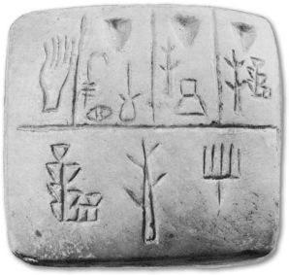

Prehistory
History
Hyperhistory
ENVELOPING THE WORLD
Those who live by the digit, die by the digit.
No ICTs
Individual and social well-being
related to ICT
Individual and social well-being
dependent on ICT

Slide 4
Prehistory
History
Hyperhistory
ENVELOPING THE WORLD
Philosophy of Nature
Philosophical Anthropology
Political Philosophy
…
Cyberculture
Posthumanism
Singularity
…

Slide 5

ENVELOPING THE WORLD
Three limits
to the speed
of growth of data:
- thermodynamics
- intelligence
- memory.

Slide 6
ENVELOPING THE WORLD
Acquisition/Storage
Usability
Security/Safety
Accessibility
Analytics
Law/Ethics
Costs

Slide 7
ENVELOPING THE WORLD

Slide 8
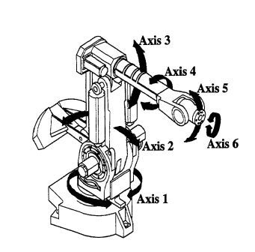
ENVELOPING THE WORLD
In recent years, the world has been adapting to AI limited capacities increasingly well.
Enveloping the world without fully realising it.
In robotics, an envelope (also known as reach envelop) is the three-dimensional space that defines the boundaries that the robot can reach.

Slide 9
ENVELOPING THE WORLD
Dishwasher vs. Humanoid Robot

Slide 10
ENVELOPING THE WORLD
Past: enveloping a stand-alone
phenomenon (e.g. factory).
Future: enveloping the environment
as an AI-friendly infosphere.

Slide 11


reality and virtuality
ENVELOPING THE WORLD
Ca. 20% of EU population used a laptop to access
the internet, via wireless away from home or work.

Slide 12
ENVELOPING THE WORLD
Robust, cumulative, progressively refining trend.

Slide 13
ENVELOPING THE WORLD
Inside the computer
Outside the computer
Back inside

Slide 14
ENVELOPING THE WORLD
Some philosophical questions:
                Small patterns?
                Zettabyte savvy?
                inscribing reality?
                green gambit?
                shifting intelligence?
                a Roomba world?
                AI’s in-betweeness?
                replaceable interfaces?
                semantic engines?
                cultural neo-dualism?

Slide 15
1. SMALL PATTERNS?
Data too big only in relation to our current computational power? Misleading.
“Big data” because small computers? No.
Epistemological problem: small patterns.

Slide 16
1. SMALL PATTERNS?
Small patterns

Slide 17
1. SMALL PATTERNS?
“You need the haystack to find the needle”, General Keith Alexander, Director of the National Security Agency (NSA).
Edward Snowden: PRISM, The Guardian and The Washington Post, June, 2013; xKeyscore, The Sydney Morning Herald and O Globo, July 2013.

Slide 18
1. SMALL PATTERNS?
Small patterns may be insignificant: half of your data is junk, you just do not know which half.

Slide 19
1. SMALL PATTERNS?
25 products allow Target to assign each shopper a “pregnancy prediction” score, estimate her due date and send coupons timed to specific stages of her pregnancy.
Small patterns may be significant if aggregated: loyalty cards and shopping suggestions.

Slide 20

1. SMALL PATTERNS?
Small patterns may be significant if correlated: same credit card used in two places/same time.

Slide 21
1. SMALL PATTERNS?
Small patterns may be significant if absent:
the silence of the dog.

Slide 22
1. SMALL PATTERNS?
To discover small patterns in big data we need increasingly powerful tools and huge data sets. “Invasive” procedures may not respect the sensitivity of the identified small patterns.

Slide 23
1. SMALL PATTERNS?
“… it takes a computing machine an infinite number of logical operations to figure out what goes on in no matter how tiny a region of space, and no matter how tiny a region of time.” Richard Feynman, The Character of Physical Law.

Slide 24

1. SMALL PATTERNS?
A fortiori, it takes a computing machine an infinite number of logical operations to figure out what goes on in the mind of a human individual, her preferences, wishes, choices, tastes, behaviour, beliefs, relations, plans, decisions…

Slide 25

1. SMALL PATTERNS?
Each individual is informationally inexhaustible, so we abstract, generalise, aggregate, interpolate, group together, classify…
Alice becomes a young woman with allergy problems, a safer driver, a potential first-home buyer…
Alice

Slide 26
1. SMALL PATTERNS?
Smart technologies and small patterns treat individuals as types, with an inevitable loss of respect for the uniqueness of each person. Paradoxically, in order to tailor interactions, services products… to Alice, we end up profiling Alice.
Alice

Slide 27
1. SMALL PATTERNS?
Risk: in a proxy culture,
the profiled becomes the profile,
the profile becomes predictable,
and the predictable becomes exploitable.
So care must be exercised in extracting and handling sensitive patterns.
Alice

Slide 28
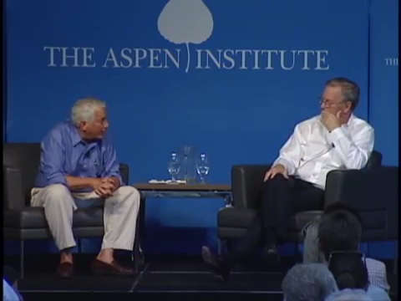
2. ZETTABYTE SAVVY?
“Many people in AI believe that we’re close to [a computer
passing the Turing Test] within the next five years”
Eric Schmidt, Executive Chairman, Google,
speaking at The Aspen Institute on July 16, 2013.

Slide 29

2. ZETTABYTE SAVVY?
Steve Worswick, creator of Mitsuku, a chatbot, won the 2013 Loebner Contest Bronze Medal ($4,000) for the most human-like computer.
The Silver Medal Prize ($25,000 + Silver Medal awarded if any program fools two or more judges when compared to two or more humans) has never been awarded.

Slide 30
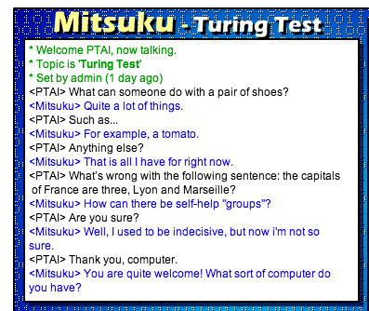
2. ZETTABYTE SAVVY?

Slide 31
3. INSCRIBING REALITY?
AI is not a “science of nature”, or a “science of culture” but a “science of the artificial” (Simon 1996).
AI does not describe nor prescribe the world.
AI inscribes the world.
Smart artefacts are new pieces of code in Galileo’s mathematical book of nature.
Notes:
AI investigates the constraining conditions that make possible to build and embed artefacts in the world and interact with it successfully.

Slide 32
4. GREEN GAMBIT?
Enveloping the world AI resources footprint
Source:
SMART 2020: Enabling the Low Carbon Economy in the Information Age, The Climate Group, 2008

Slide 33
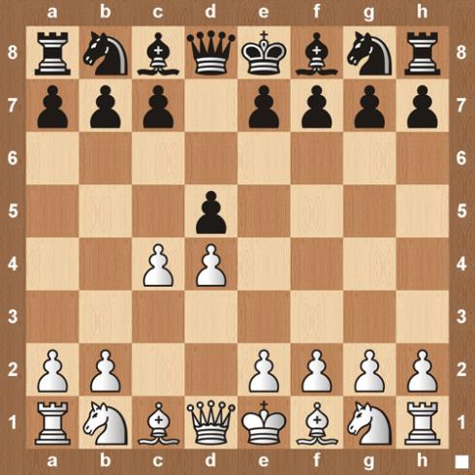
4. GREEN GAMBIT?
Voluntary risk
Involving a significant loss
Taken strategically
In order to gain a significant advantage, that is
Higher than (and compensates for) the original loss.
It follows the logic of worse before better (WBB).

Slide 34
4. GREEN GAMBIT?
Voluntary risk, involving a significant loss, taken strategically, in order to gain a significant advantage, that is higher than (and compensates for) the original loss.
System A
uncertainty
gambit
financial crisis: cuts
military conflict: surge epidemic disease: culling
performance\state
time
Notes:
For illustration purposes only (food package)

Slide 35
4. GREEN GAMBIT?
environment
System A
ICT
System B
performance\state
The WBB phase increasingly less acute (y) and shorter (x) the better the ICT and the metatechnologies in place are.
the WBB phase: the solution
worsens the problem.
time
Notes:
For illustration purposes only (food package)

Slide 36
5. SHIFTING INTELLIGENCE?
“The End of Theory: The Data Deluge Makes the Scientific Method Obsolete”, Chris Anderson, Wired, 23 June, 2008.
“Is Google Making Us Stupid? What the Internet is Doing to Our Brains”, Nicholas Carr, The Atlantic, July 1, 2008.
Notes:
2008: Bankruptcy of Lehman Brothers

Slide 37
6. A ROOMBA WORLD?
By enveloping the world, our technologies might shape our physical and conceptual environments and constrain us to adjust to them because that is the best, or the only, way to make things work.
The stupid and laborious vs. the intelligent but lazy spouse: who adapts to whom?
A Roomba-friendly environment.

Slide 38
7. AI’S IN-BETWEENESS?
A hat is a technology between you and the sunshine. A pair of sandals is a technology between you and the beach on which you are walking. And a pair of sunglasses is between you and the bright light that surrounds you.
User
Technology
Prompter

Slide 39
7. AI’S IN-BETWEENESS?
First-order technology.
A wood-splitting axe is a first-order technology between you, the user, and the wood, the prompter.
Other examples: nail clippers, assault rifle…
Humanity
Technology
Nature

Slide 40
7. AI’S IN-BETWEENESS?
Second-order technology.
The engine, understood as any technology that provides energy to other technologies, is probably the most important, second-order technology (industrial revolution, modernity).
Humanity
Technology
Technology

Slide 41
7. AI’S IN-BETWEENESS?
Third-order technology.
AI is a typical third-order technology insofar as it can process data autonomously and so be in charge of related behaviours. Smart agents no longer need to be human.
Technology
Technology
Technology

Slide 42
7. AI’S IN-BETWEENESS?
History, esp. mechanical modernity, is still human-dependent. However, fully automated, computational systems may not need human interactions at all in order to exist and grow. Hyperhistory can in principle be human-independent. We are not even on the loop.
Technology
Technology
Technology

Slide 43
8. REPLEACEABLE INTERFACES?
We often work as interfaces between technologies.

Slide 44
8. REPLEACEABLE INTERFACES?
We often work as interfaces between technologies.

Slide 45
8. REPLEACEABLE INTERFACES?
AI may easily and rightly make us redundant.
However, this may mean to be asked to do more.

Slide 46
9. SEMANTIC ENGINES?
Memory outperforms intelligence
but syntactic engines may need semantic ones.

Slide 47
10. CULTURAL NEO-DUALISM?
    Information
    Meanings
    Semantics
    Qualitative
    …
        Data
        Patterns
        Syntax
        Quantitative
        …

Slide 48
ENVELOPING THE WORLD
Some philosophical questions:
                Small patterns?
                Zettabyte savvy?
                inscribing reality?
                green gambit?
                shifting intelligence?
                a Roomba world?
                AI’s in-betweeness?
                replaceable interfaces?
                semantic engines?
                cultural neo-dualism?

Slide 49
CONCLUSION
The General Framework: from History to Hyperhistory
Prehistory
History
Hyperhistory
History as the age of humans
as the information agents.
Hyperhistory as the age
of hybrid, multiagent,
information systems.

Slide 50
CONCLUSION: THE IMPORTANCE OF DESIGN
    Being able to see what the future will be like and what adaptive demands smart technologies will place on humanity is vital in order to devise solutions that can lower their anthropological costs and rise their environmental benefits.

Slide 51
CONCLUSION: THE IMPORTANCE OF DESIGN
    Human intelligent design should play a major role in shaping the future of our interactions with forthcoming smart artefacts.
    After all, it is a sign of intelligence to make stupidity work for you.

Slide 52
ENVELOPING THE WORLD
HOW REALITY IS BECOMING AI-FRIENDLY
Luciano Floridi
www.philosophyofinformation.net
SOURCES
This research is partly based on The Fourth Revolution – How the Infosphere is Reshaping Human Reality (Oxford University Press, June 2014).
ACKNOWLEDGEMENTS
This research has been supported by an AHRC grant.
COPYRIGHT DISCLAIMER
Texts, marks, logos, names, graphics, images, photographs, illustrations, artwork, audio clips, video clips, and software copyrighted by their respective owners are used on these slides for non-commercial, educational and personal purposes only. Use of any copyrighted material is not authorized without the written consent of the copyright holder. Every effort has been made to respect the copyrights of other parties. If you believe that your copyright has been misused, please direct your correspondence to: luciano.floridi@oii.ox.ac.uk stating your position and I shall endeavour to correct any misuse.

